Slide 1
An overview of Boosting

Slide 2
Plan of talk
Generative vs. non-generative modeling
Boosting
Alternating decision trees
Boosting and over-fitting
Applications

Slide 3
Generative vs. Discriminative Models

Slide 4


Toy Example
Computer receives telephone call
Measures Pitch of voice
Decides gender of caller
Male
Human
Voice
Female

Slide 5


Generative modeling
mean1
mean2
var1
var2
Probability
Voice Pitch

Slide 6
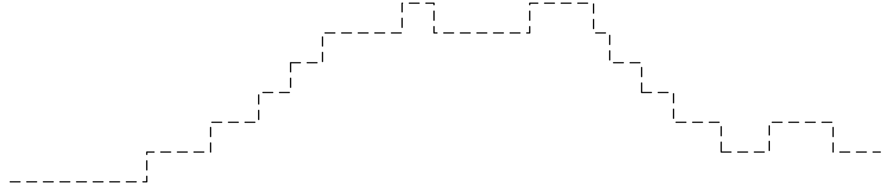
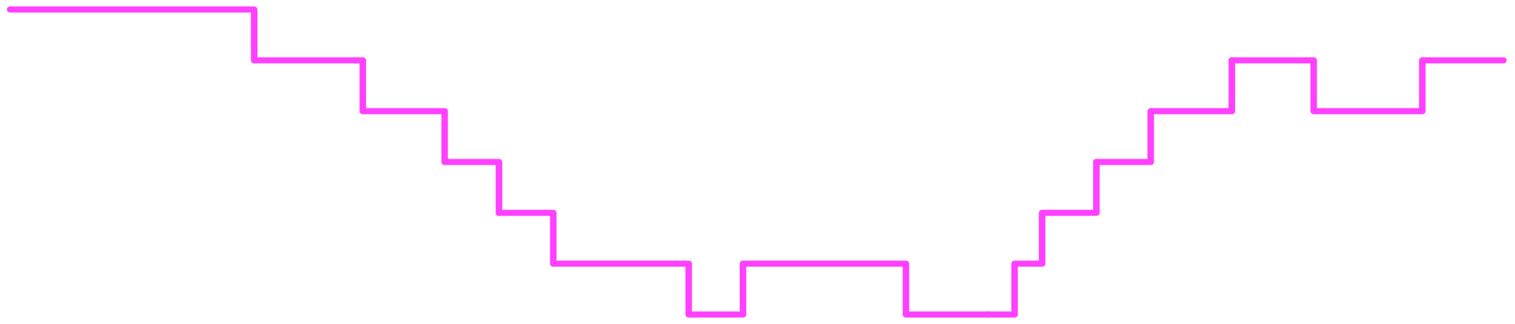
Discriminative approach
[Vapnik 85]
No. of mistakes
Voice Pitch

Slide 7
Ill-behaved data
mean1
mean2
Probability
No. of mistakes
Voice Pitch

Slide 8
Traditional Statistics vs. Machine Learning
Machine Learning
Estimated
world state
Decision
Theory
Predictions
Actions
Data
Statistics

Slide 9
Comparison of methodologies
Model | Generative | Discriminative
Goal | Probability estimates | Classification rule
Performance measure | Likelihood | Misclassification rate
Mismatch problems | Outliers | Misclassifications

Slide 10
Summary
Generative models: goal is to explain how data is generated.
Discriminative models: goal is to predict a property of the data (such as label)
Generative models are more accurate when they are correct.
Discriminative models are more robust against poor modeling or outliers.
Next: My favorite discriminative modelBoosting

Slide 11
Boosting

Slide 12
A weighted training set
Feature vectors
Binary labels {-1,+1}
Positive weights
Notes:
1 min

Slide 13

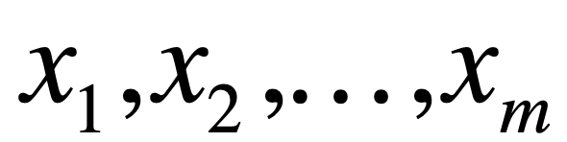
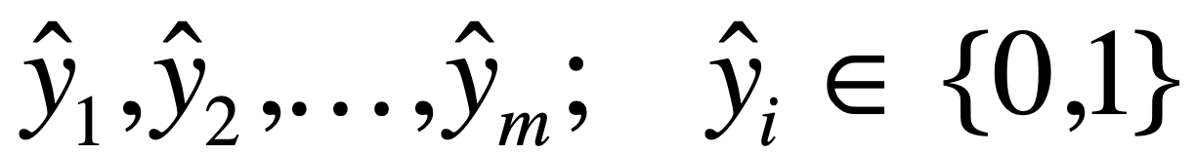
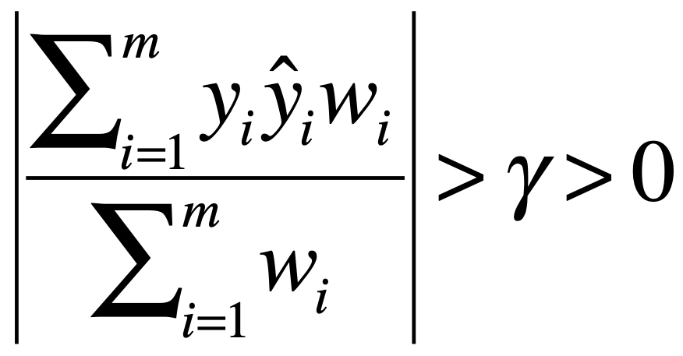
A weak learner
Weighted
training set
A weak rule
Weak Learner
h
instances
predictions
h
{-1,+1}
The weak requirement:
Notes:
3 min

Slide 14
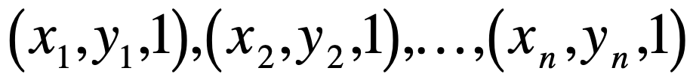
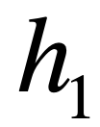
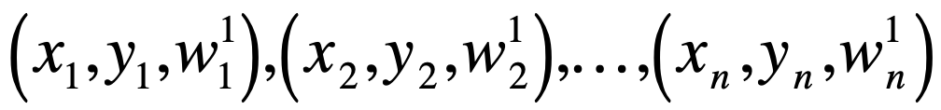
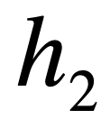
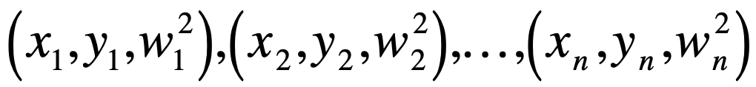
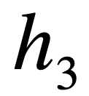
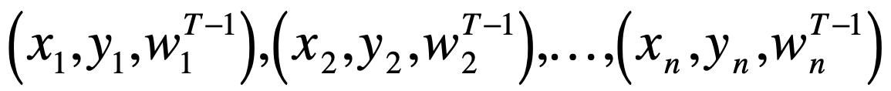
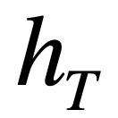
The boosting process
weak learner
weak learner
...
Notes:
2 min

Slide 15
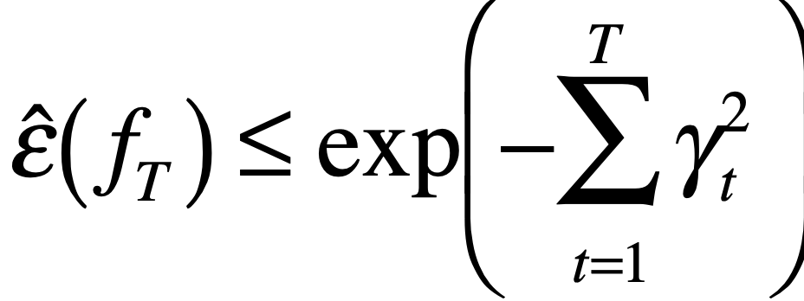
Main property of Adaboost
If advantages of weak rules over random guessing are: γ1,γ2,..,γT then training error of final rule is at most
Notes:
1 min

Slide 16
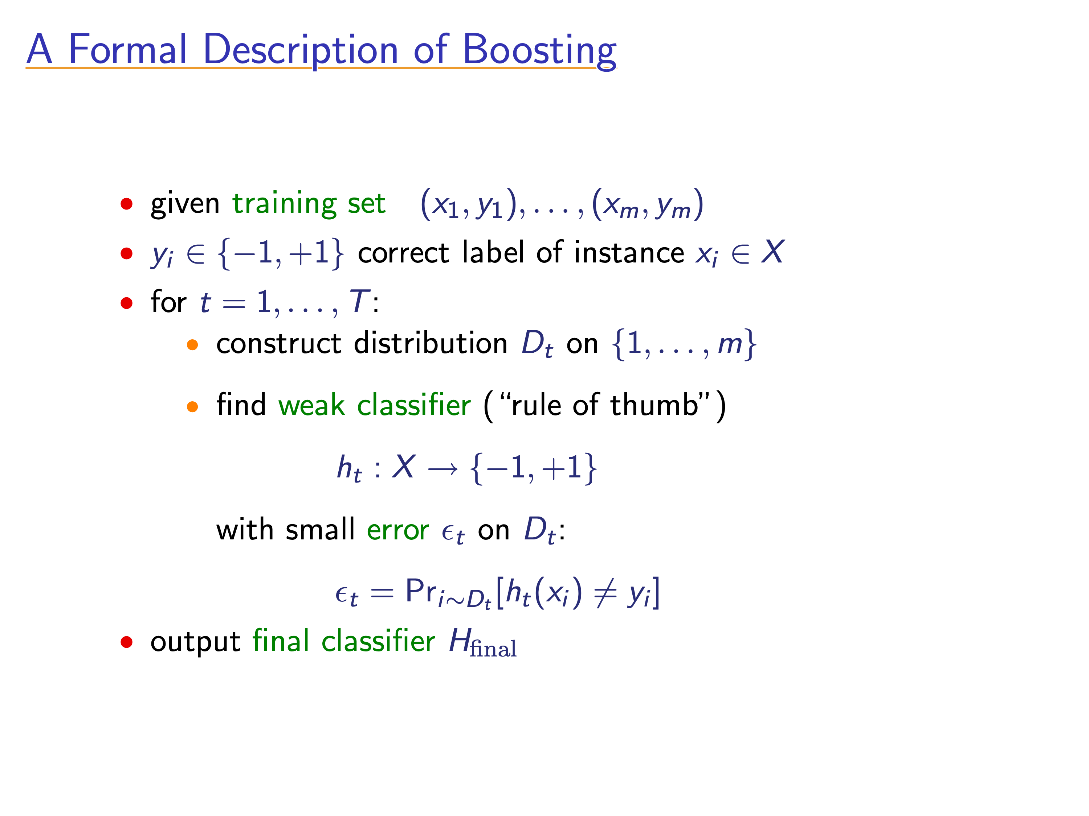
[Slides from Rob Schapire]

Slide 17
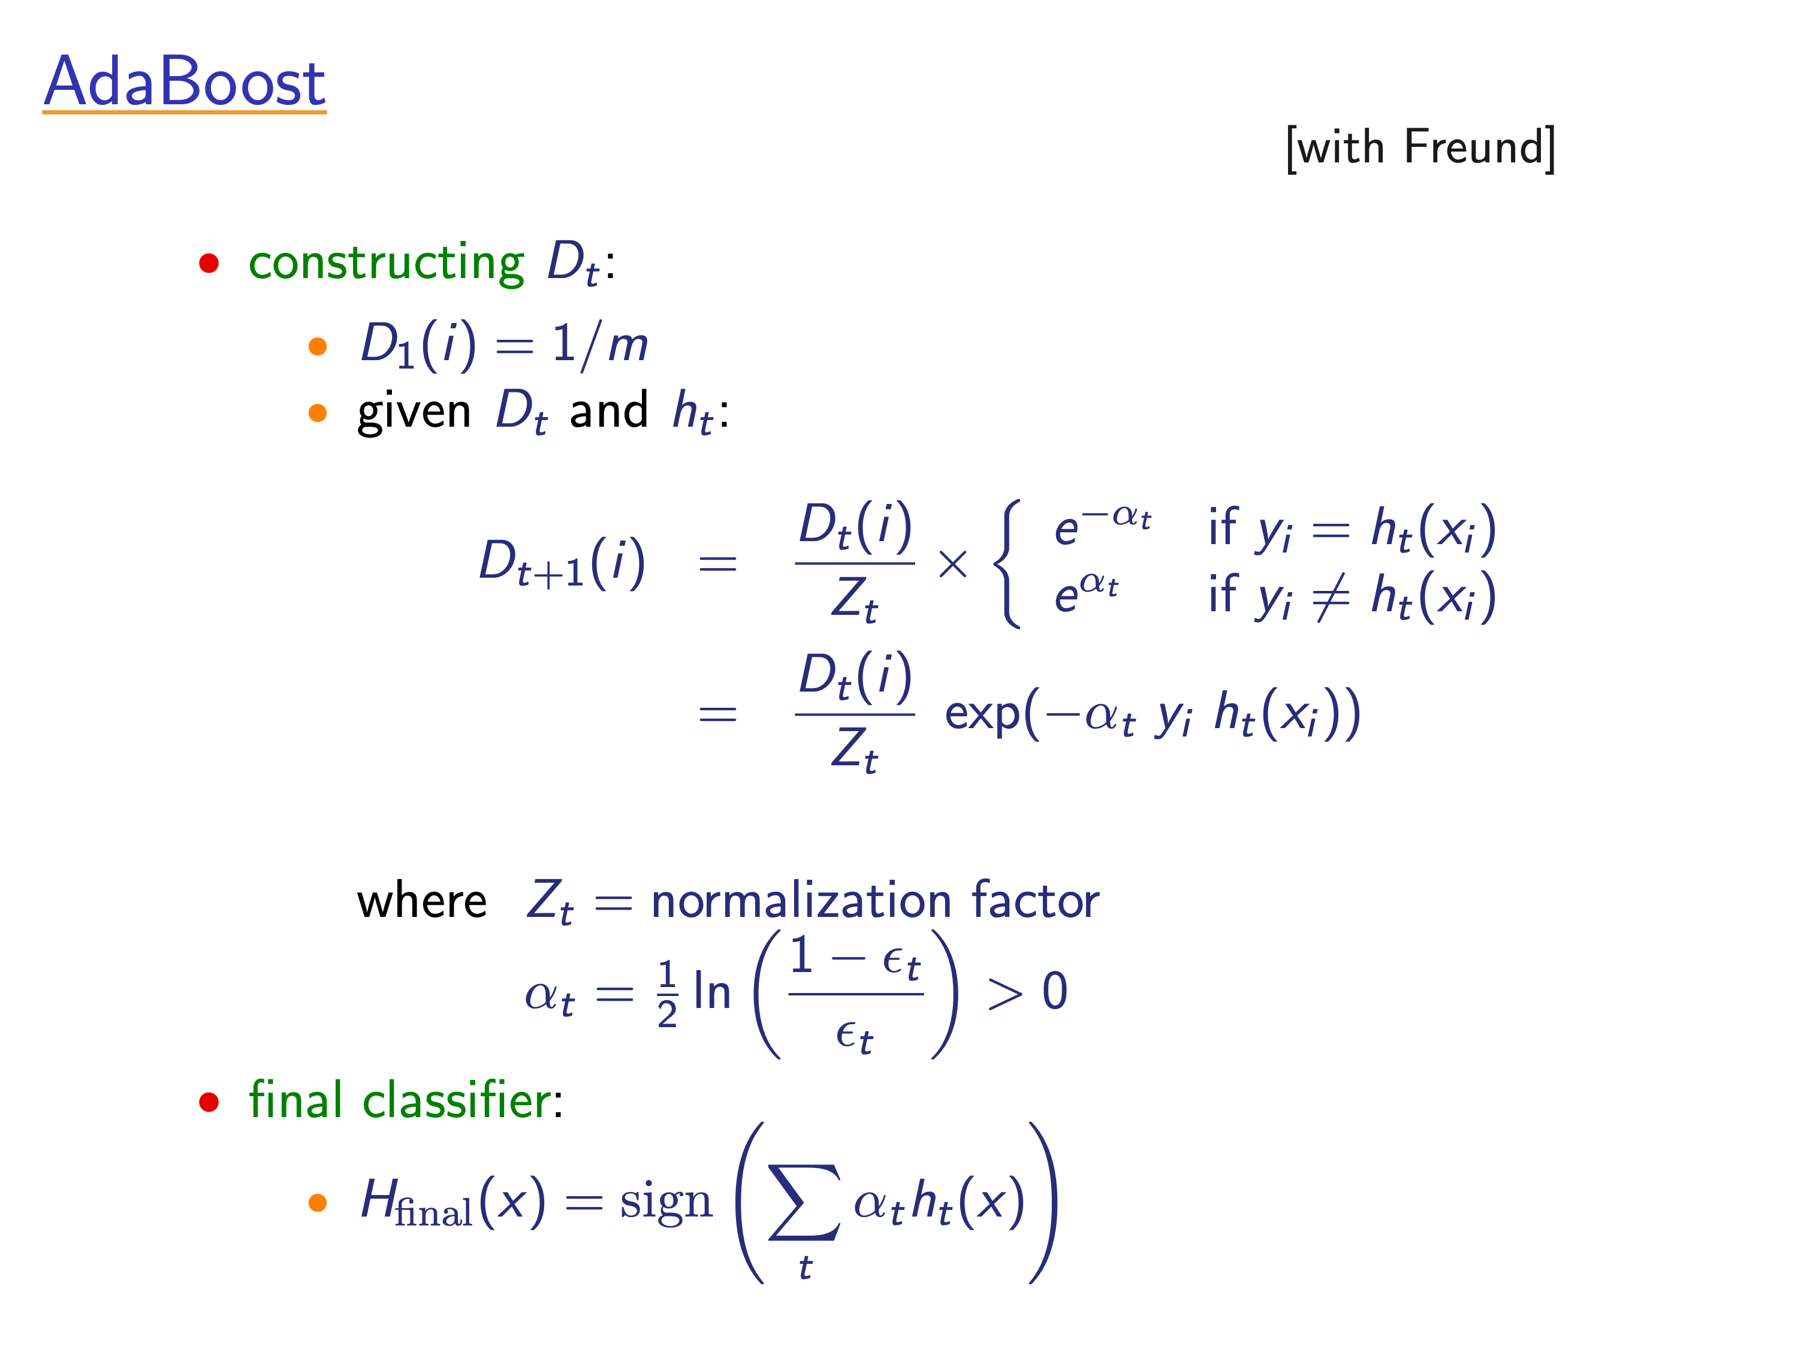
[Slides from Rob Schapire]

Slide 18
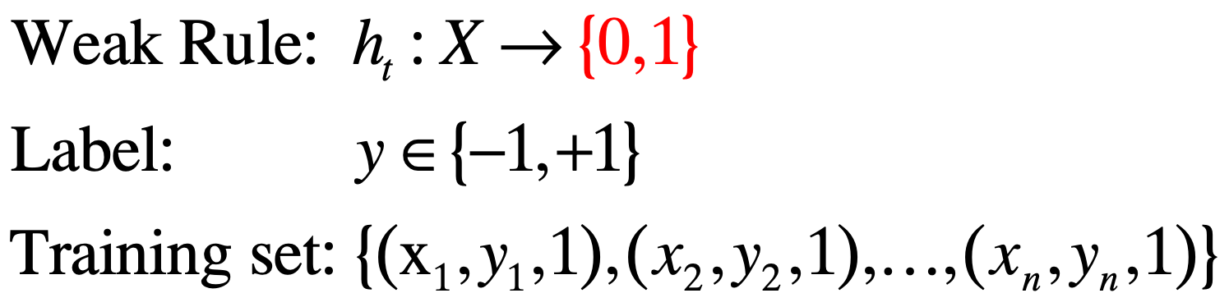
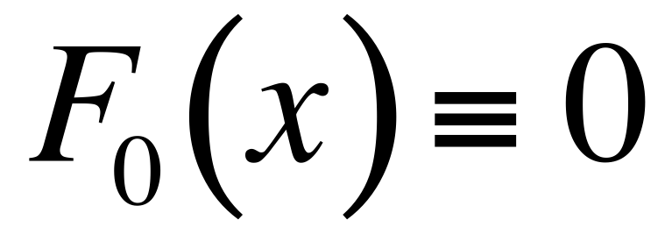
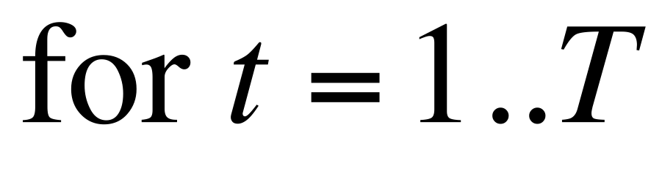
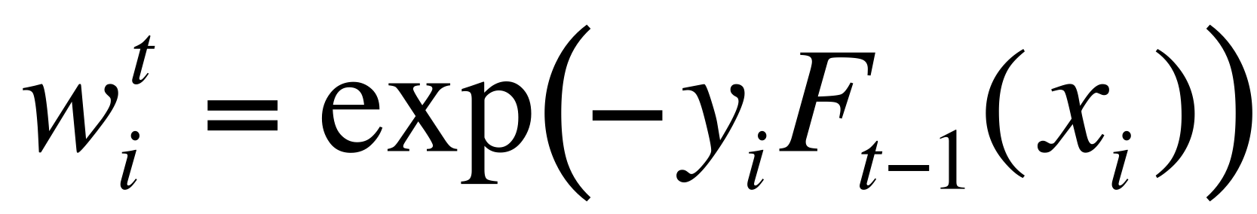
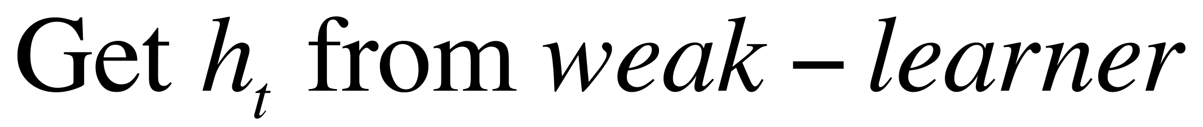
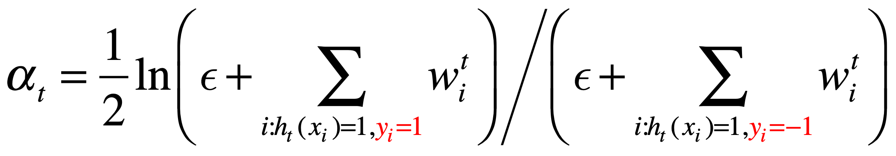
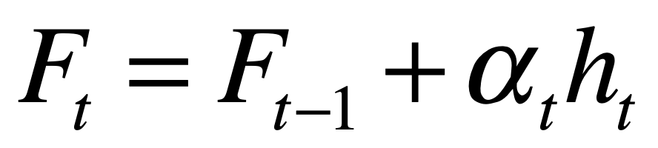
Adaboost
Freund, Schapire 1997
+
-
Notes:
3 min

Slide 19
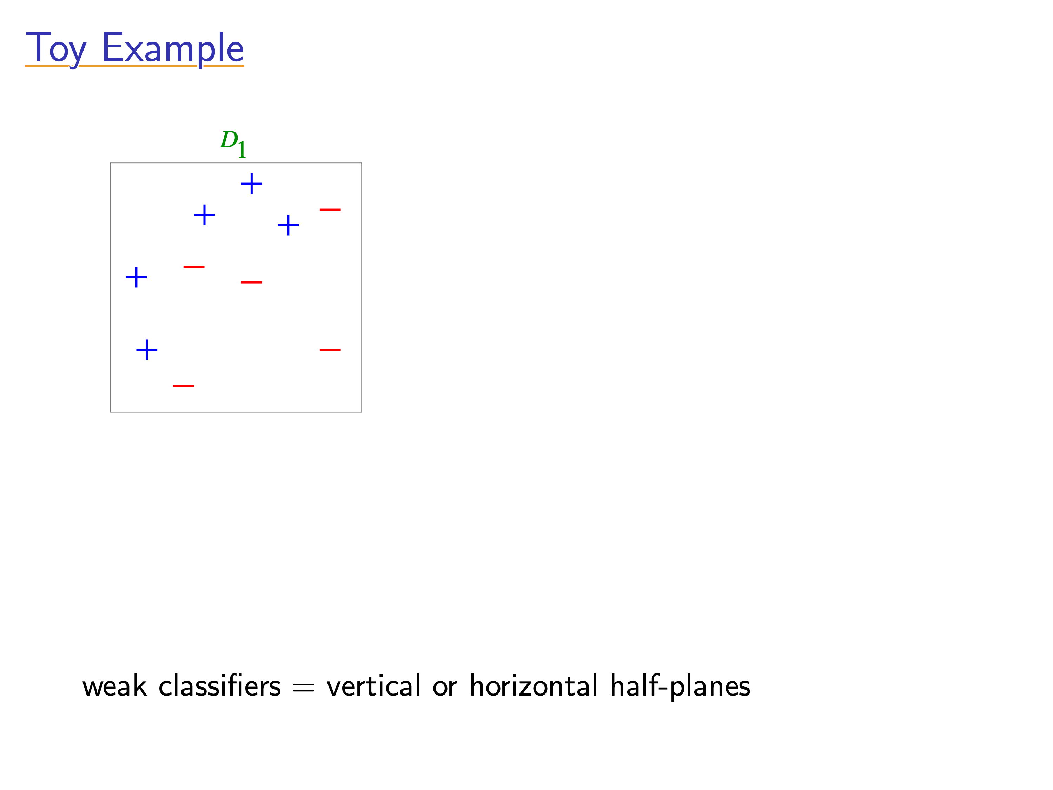
[Slides from Rob Schapire]

Slide 20
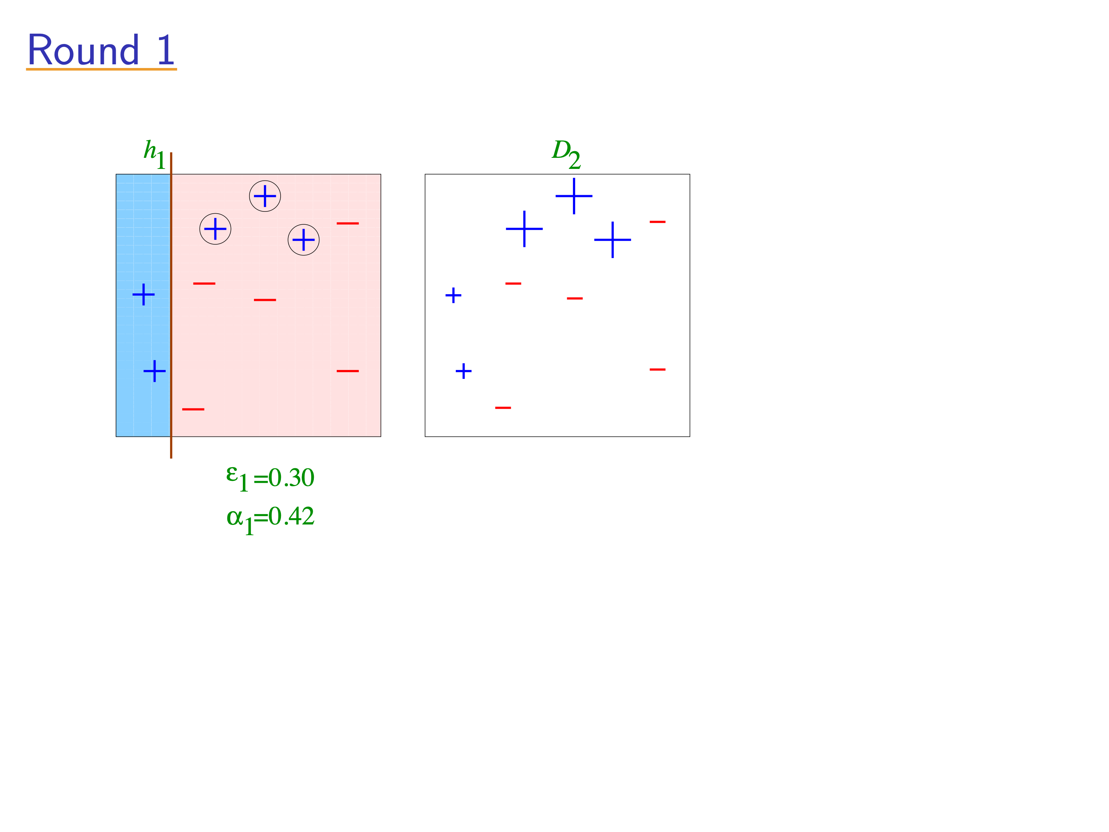
[Slides from Rob Schapire]

Slide 21
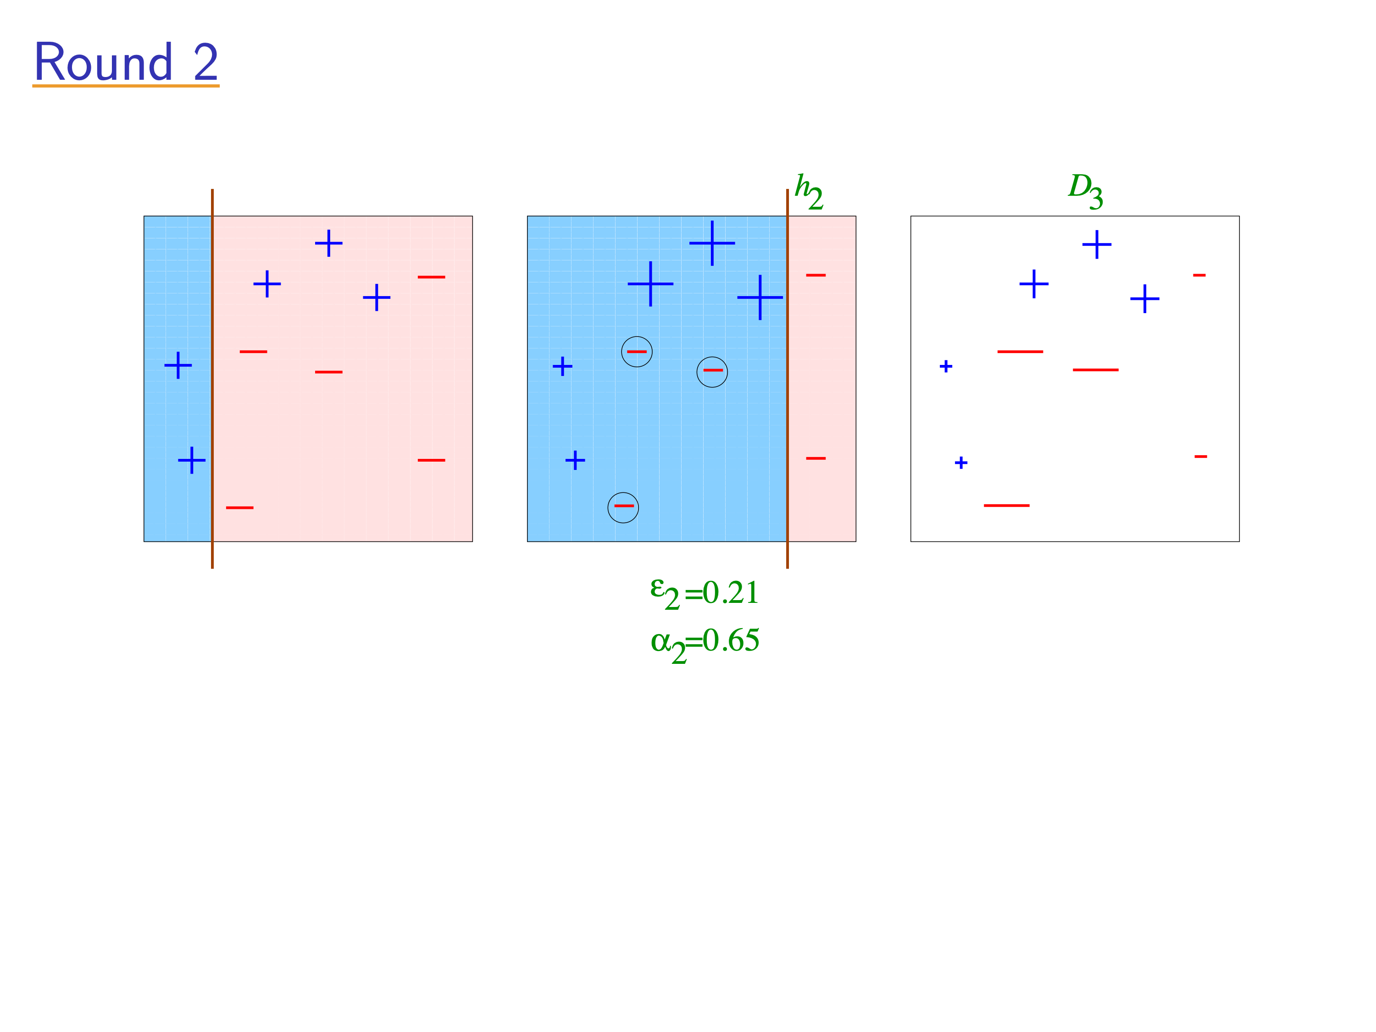
[Slides from Rob Schapire]

Slide 22
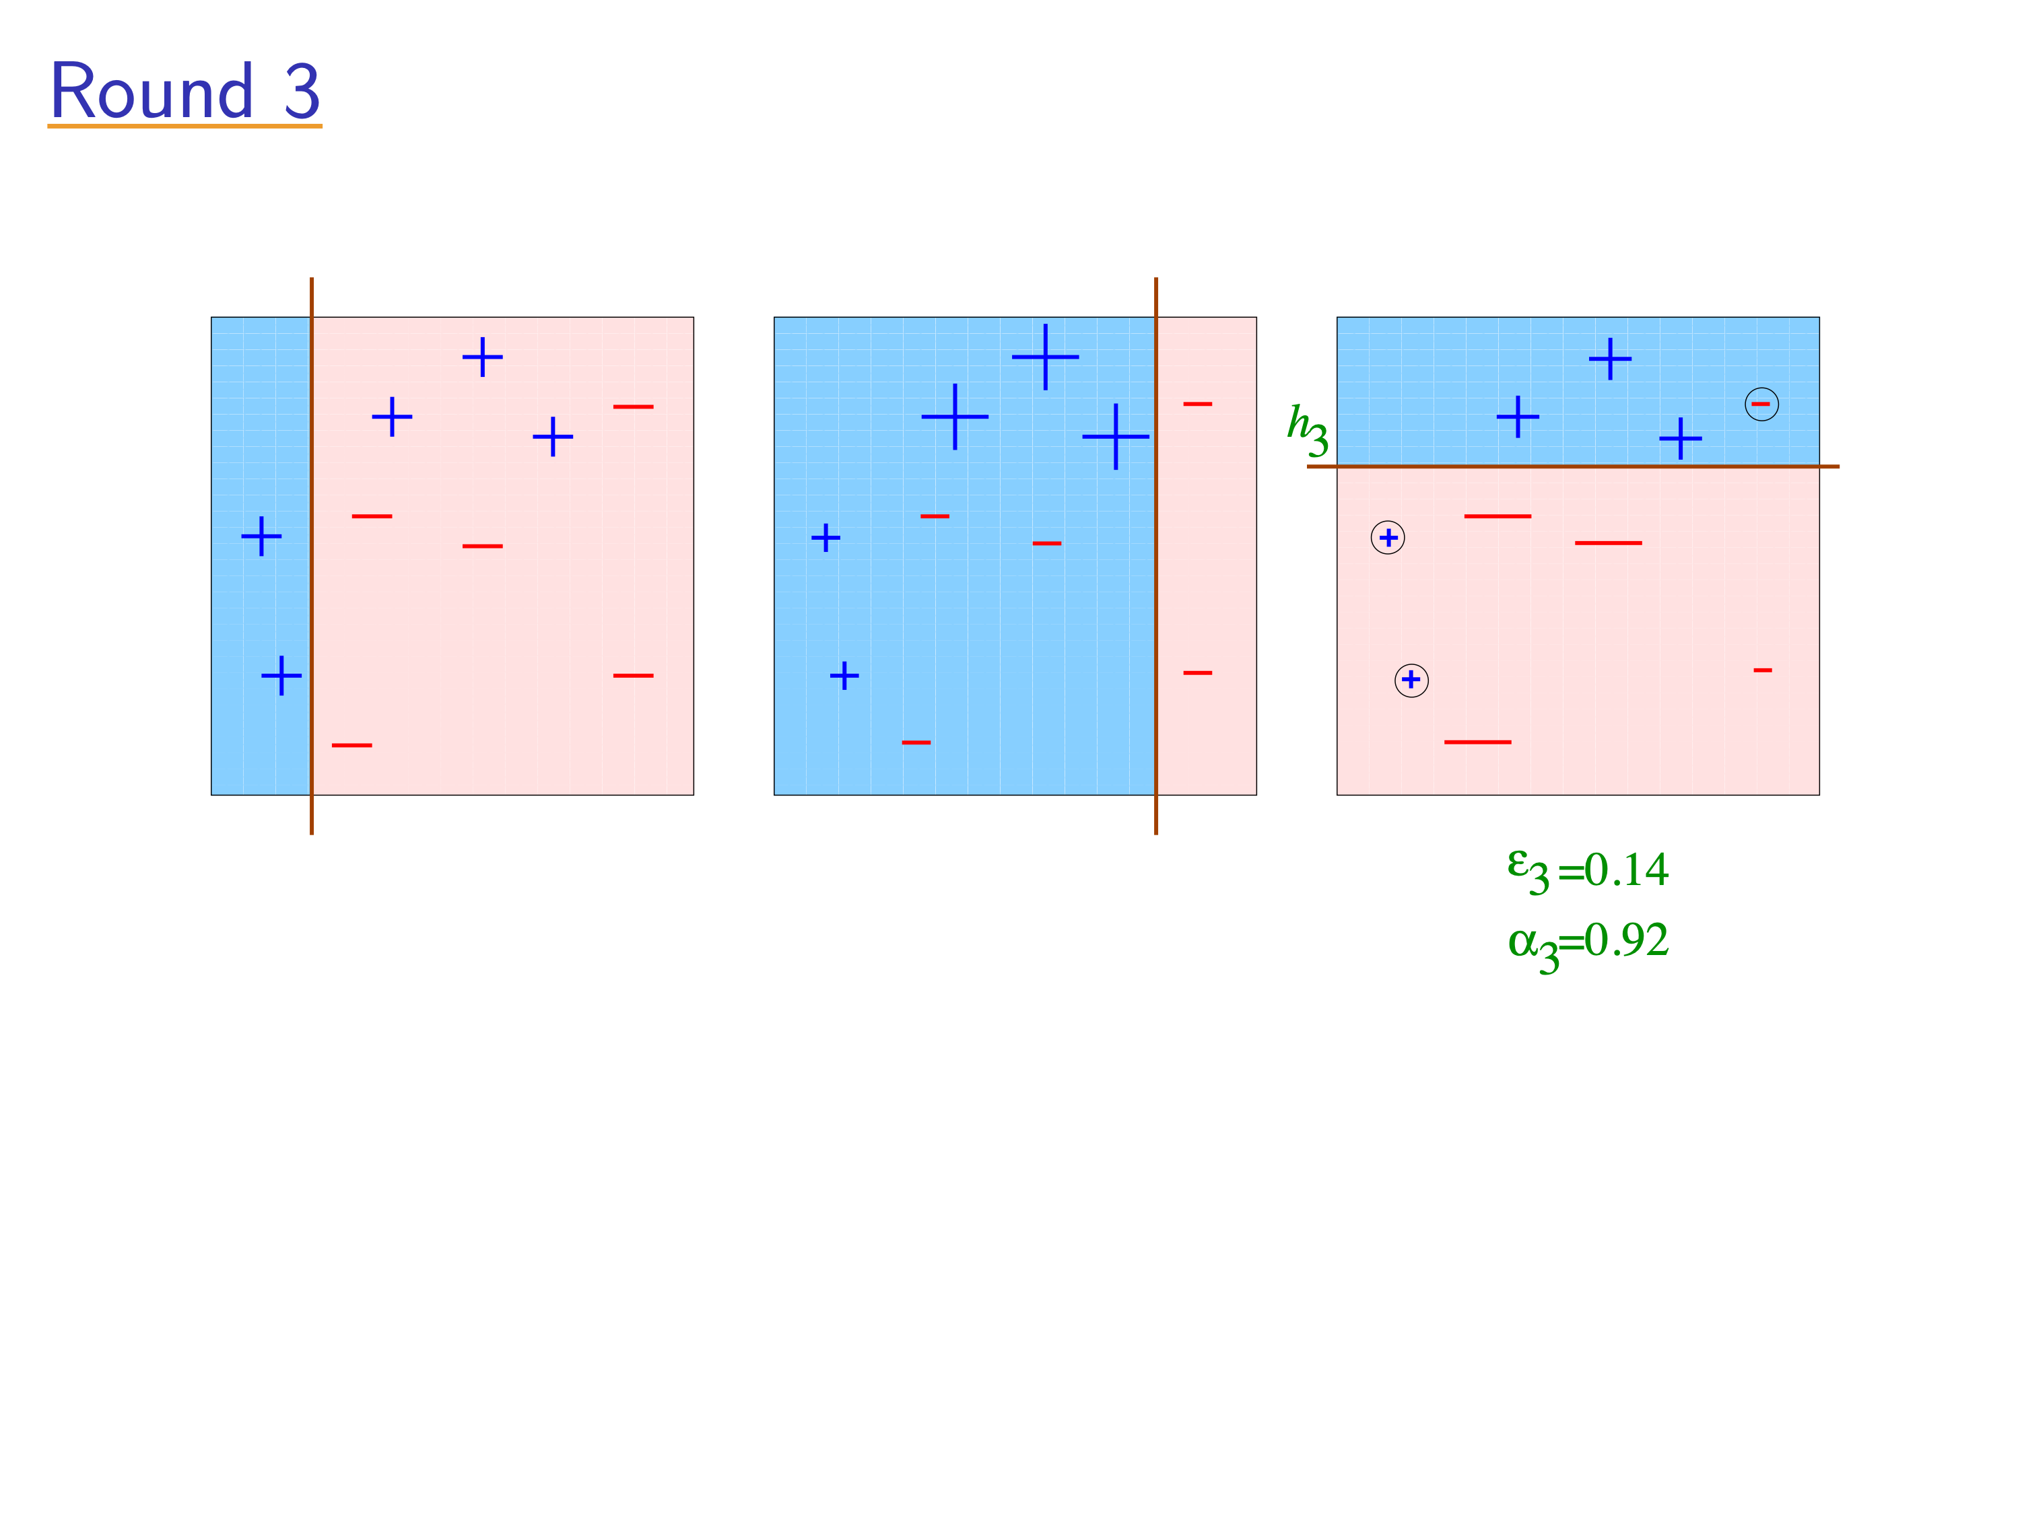
[Slides from Rob Schapire]

Slide 23
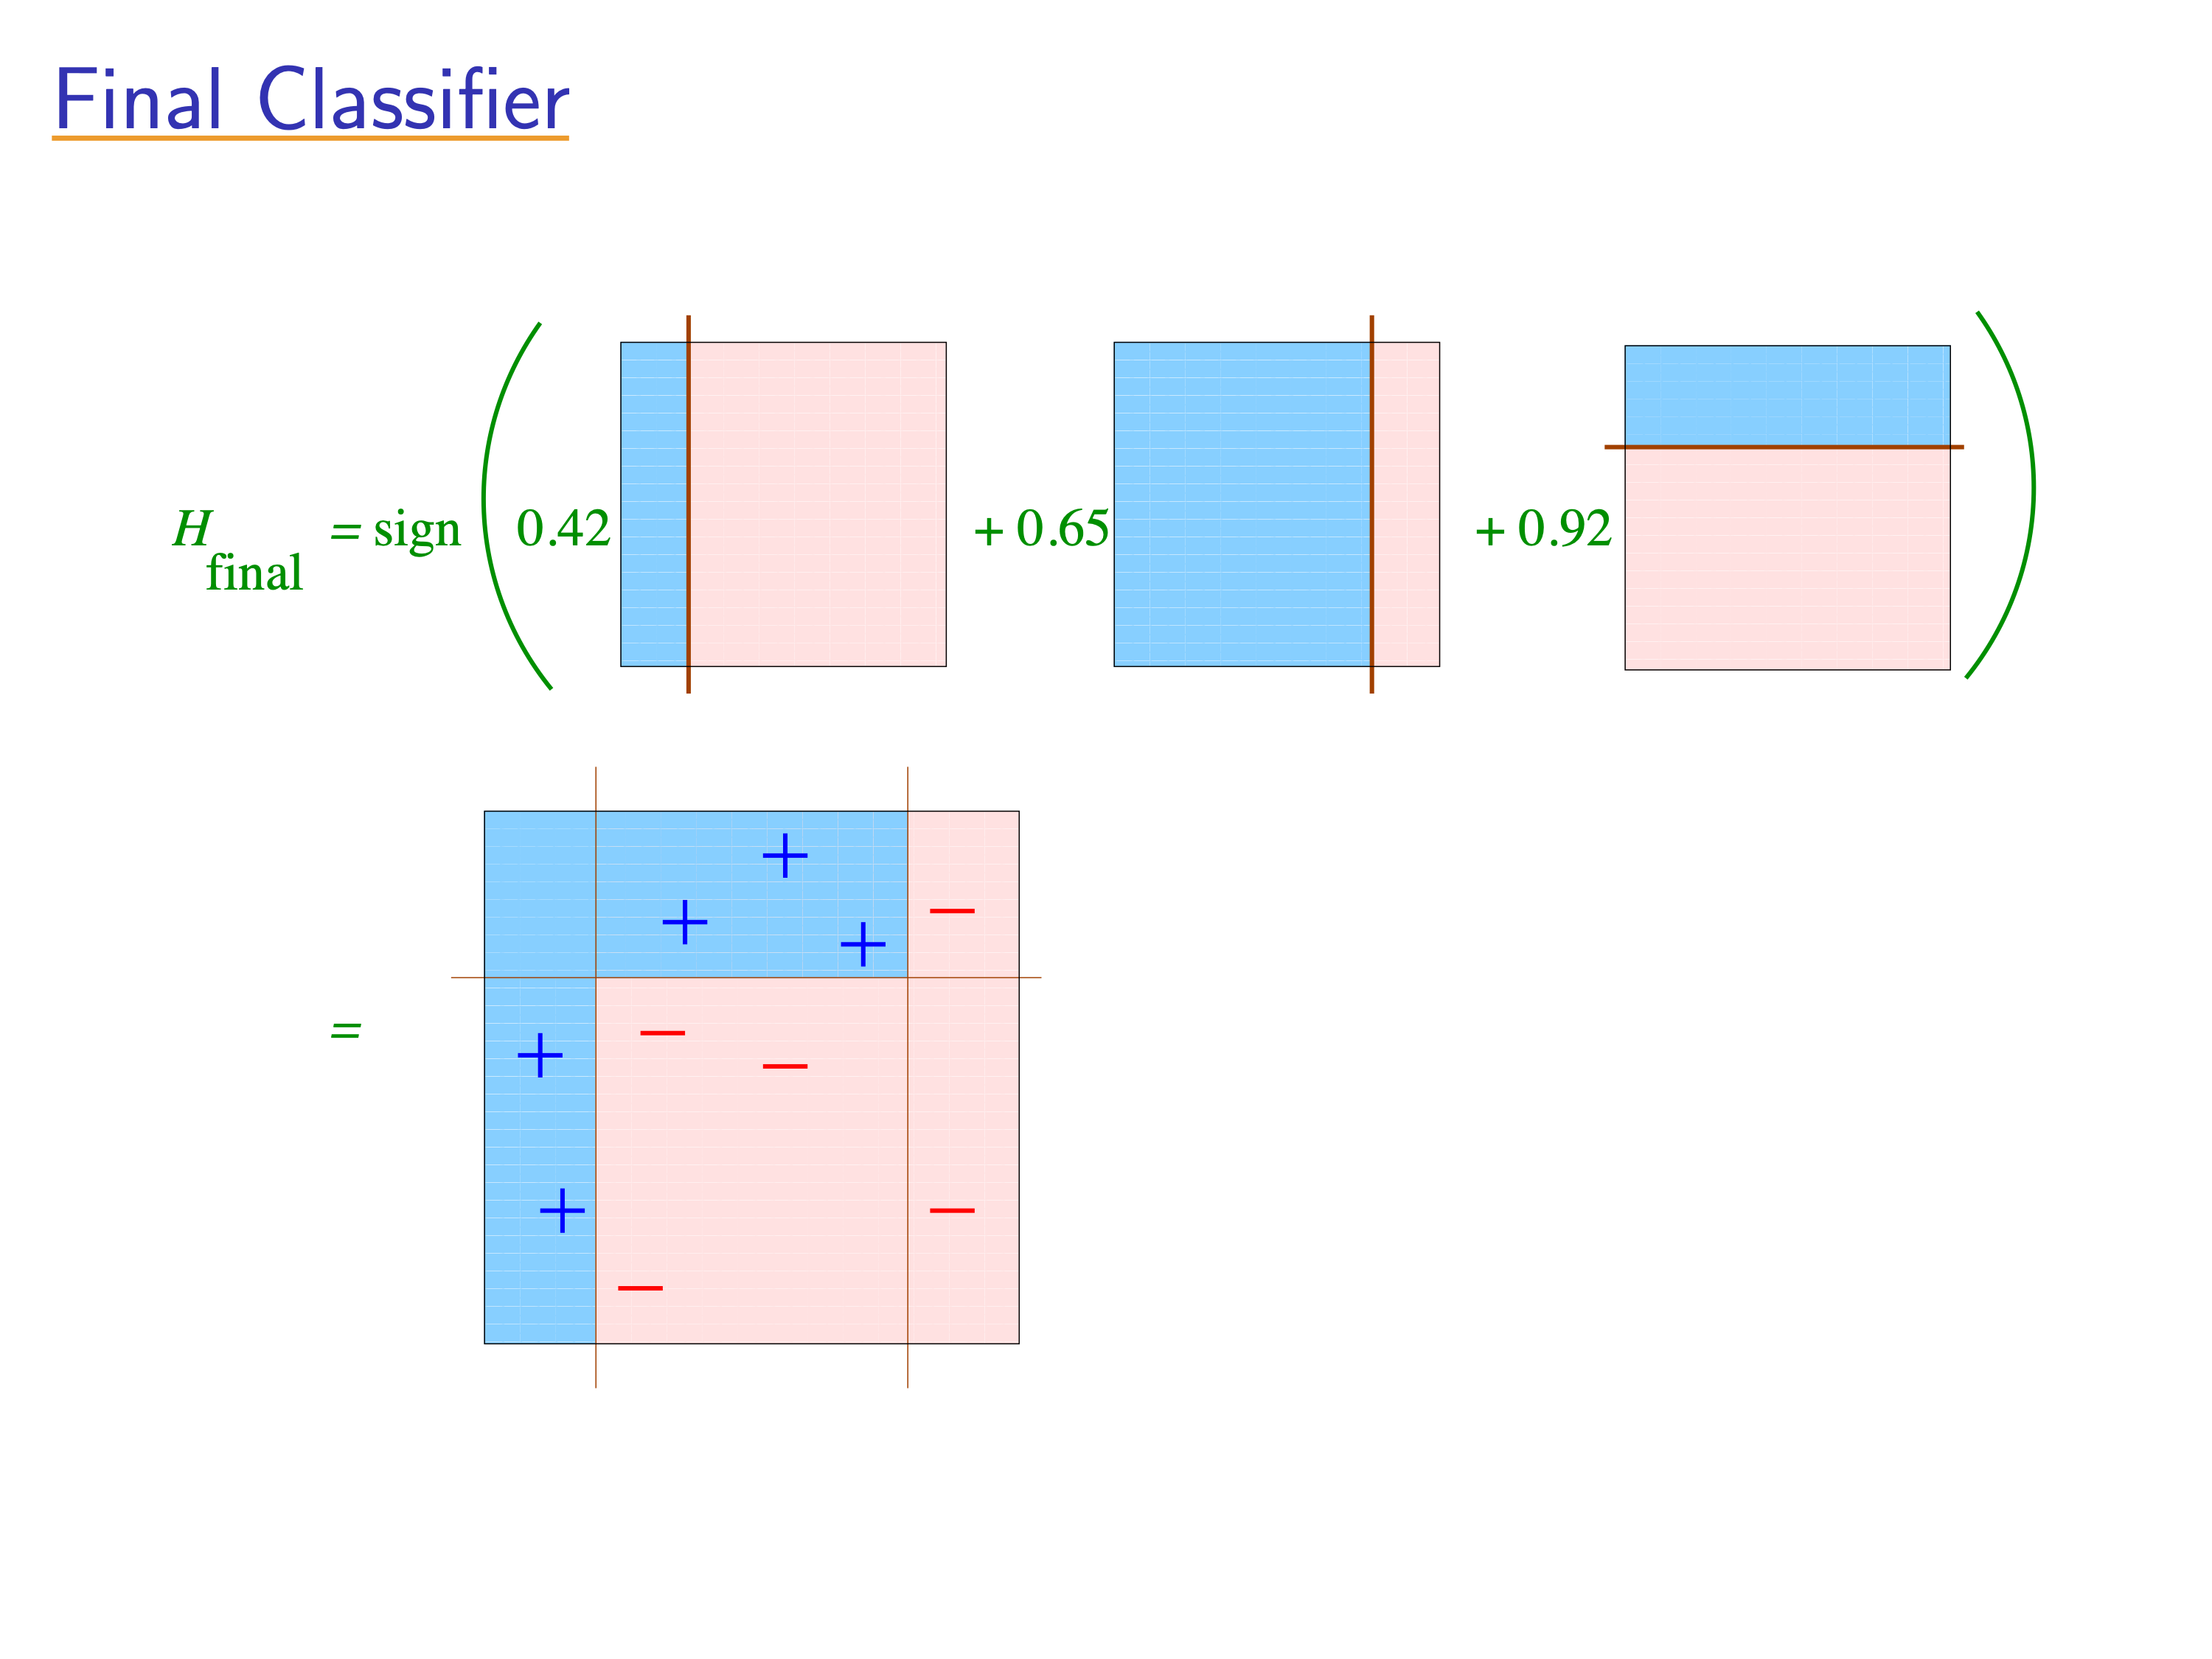
[Slides from Rob Schapire]

Slide 24
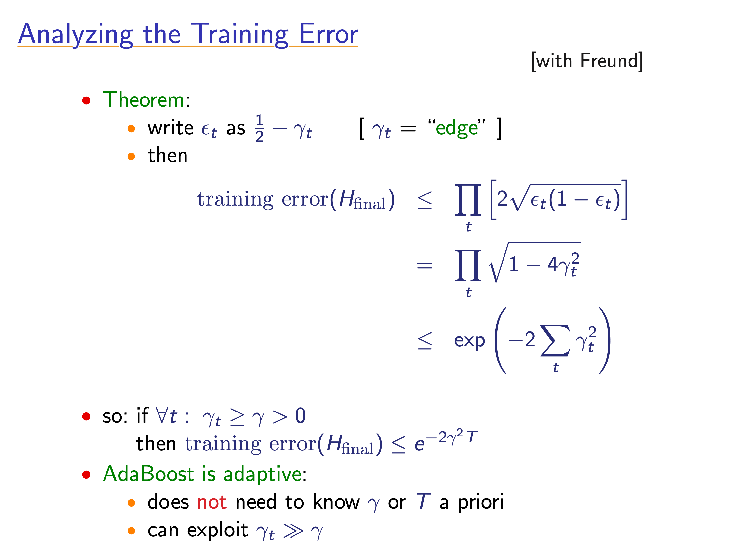
[Slides from Rob Schapire]

Slide 25
Boosting block diagram
Strong Learner
Accurate
Rule
Weak
Learner
Weak
rule
Example
weights
Booster
Notes:
1 min

Slide 26
Summary
Adaboost is an algorithm for combining weak learners.
The resulting weighted majority rule is more accurate than any of the weak rules.
Intuitively: boosting concentrates on the hard examples.
Next: some of the many ways to understand boosting.

Slide 27
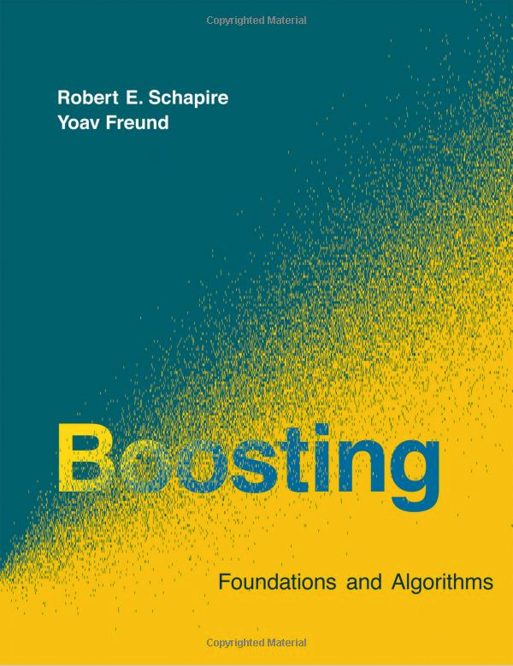
Santa Cruz Summer School 2012

Slide 28
Boosting as gradient descent

Slide 29
AdaBoost as variational optimization.
x = input, a scalar,
y = output, -1 or +1
(x1,y1),(x2,y2), … ,(xn,yn) = training set
Ft-1 = Strong rule after t-1 boosting iterations.
ht = Weak rule produced at iteration t
ht
Ft-1
+
+
+
+
+
+
+
+
+
+
+
+
+
x
-
-
-
-
-
-
-
-
-
-
-
-
-
-
-
-
-
-

Slide 30
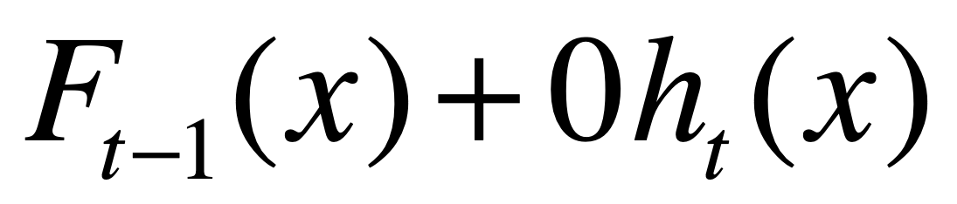
AdaBoost as variational optimization.
Ft-1 = Strong rule after t-1 boosting iterations.
ht = Weak rule produced at iteration t
ht
Ft-1
+
+
+
+
+
+
+
+
+
+
+
+
+
x
-
-
-
-
-
-
-
-
-
-
-
-
-
-
-
-
-
-

Slide 31
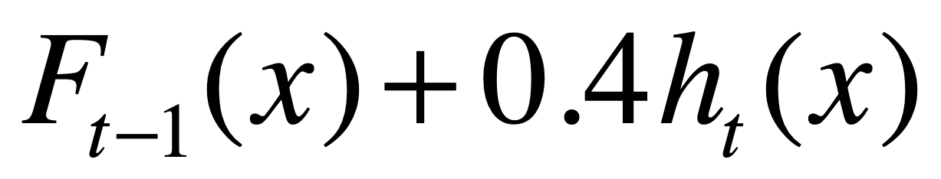
AdaBoost as variational optimization.
Ft-1 = Strong rule after t-1 boosting iterations.
ht = Weak rule produced at iteration t
ht
Ft-1
+
+
+
+
+
+
+
+
+
+
+
+
+
x
-
-
-
-
-
-
-
-
-
-
-
-
-
-
-
-
-
-

Slide 32
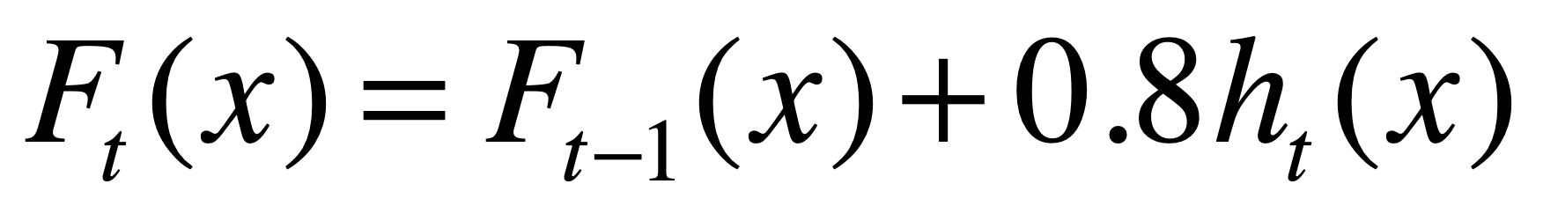
AdaBoost as variational optimization.
Ft-1 = Strong rule after t-1 boosting iterations.
ht = Weak rule produced at iteration t
ht
Ft-1
+
+
+
+
+
+
+
+
+
+
+
+
+
x
-
-
-
-
-
-
-
-
-
-
-
-
-
-
-
-
-
-

Slide 33
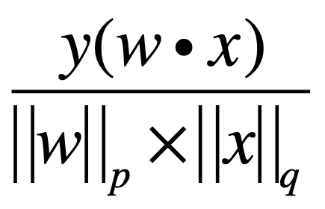
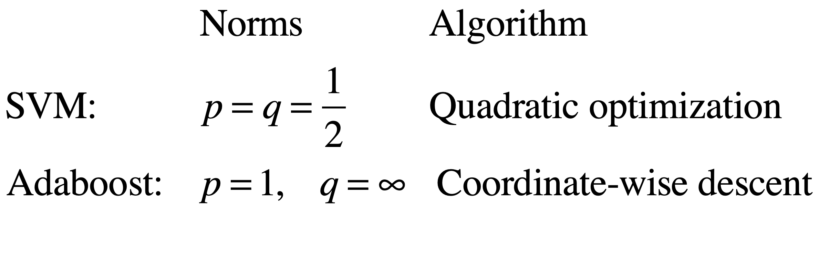
SVM vs Adaboost
Margin =

Slide 34
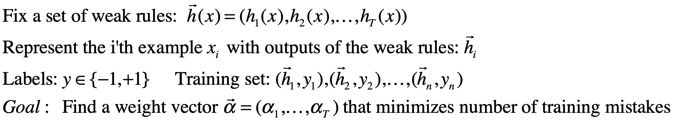
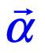
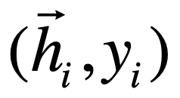
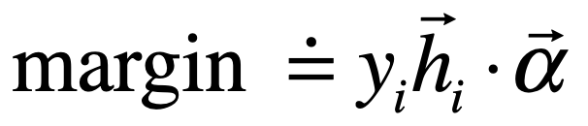
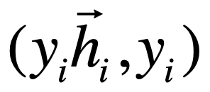
Margins
-
-
+
+
+
-
-
+
+
+
-
-
+
-
-
reflect
Correct
+
+
Cumulative # examples
-
+
+
Project
Mistakes
Correct
-
+
Mistake
+
-
-
-
+
-
-
-
Margin

Slide 35
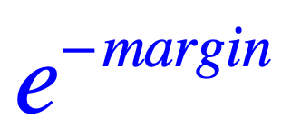
Boosting as gradient descent
Adaboost :
Our goal is to minimize the number of mistakes (0-1 loss)
Unfortunately, the step function has deriv. zero at all points other than at zero where the derivative is undefined.
Ada boost uses an upper bound on the 0-1 loss.
Adaboost minimizes the exponential loss which is an upper bound.
Finds the vector \alpha through coordinate-wise gradient descent.
Weak rules are added one at a time.
Loss
0-1 loss
Margin
Mistakes
Correct

Slide 36
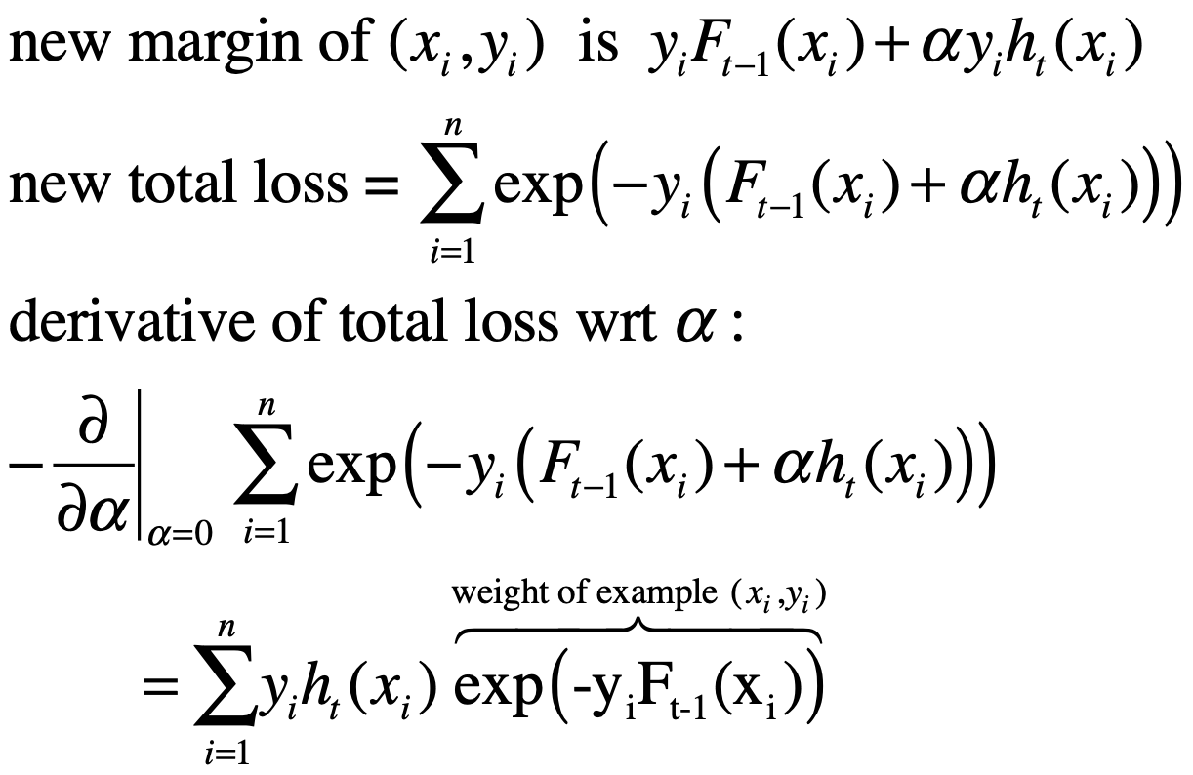


Adaboost as gradient descent
Weak rules are added one at a time.
Fixing the alphas for 1..t-1, find alpha for the new rule (ht)
Weak rule defines how each example would move = increase or decrease the margin.
0-1 loss
Margin
Mistakes
Correct

Slide 37
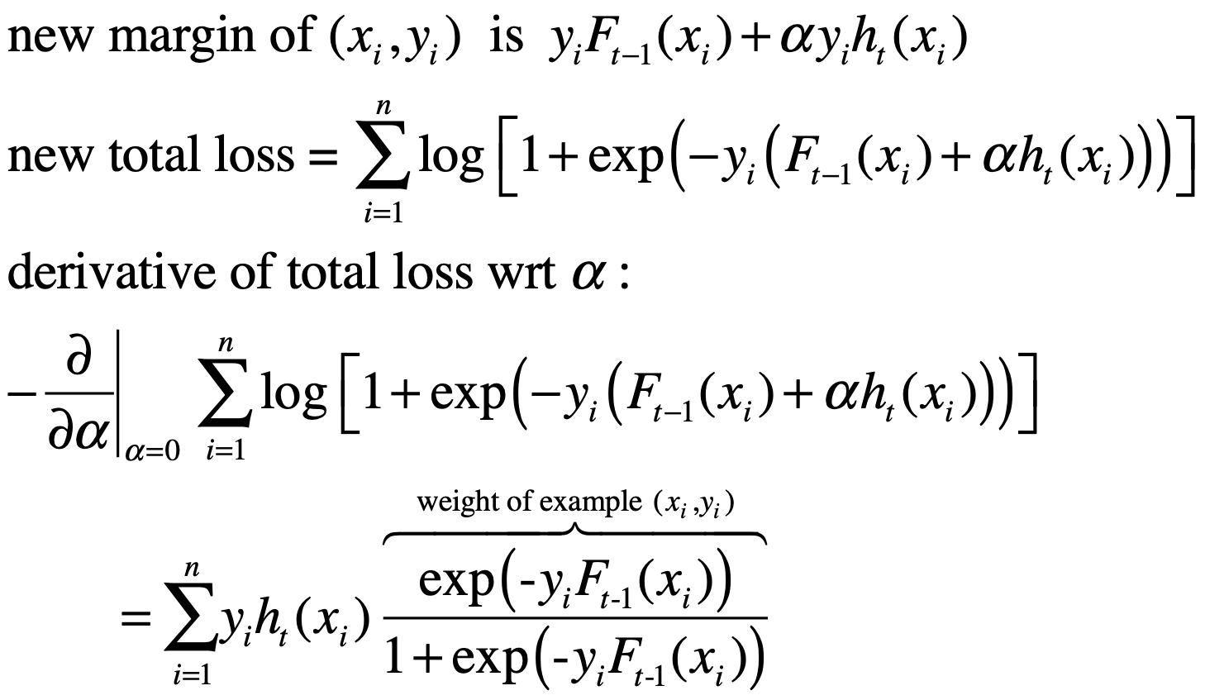
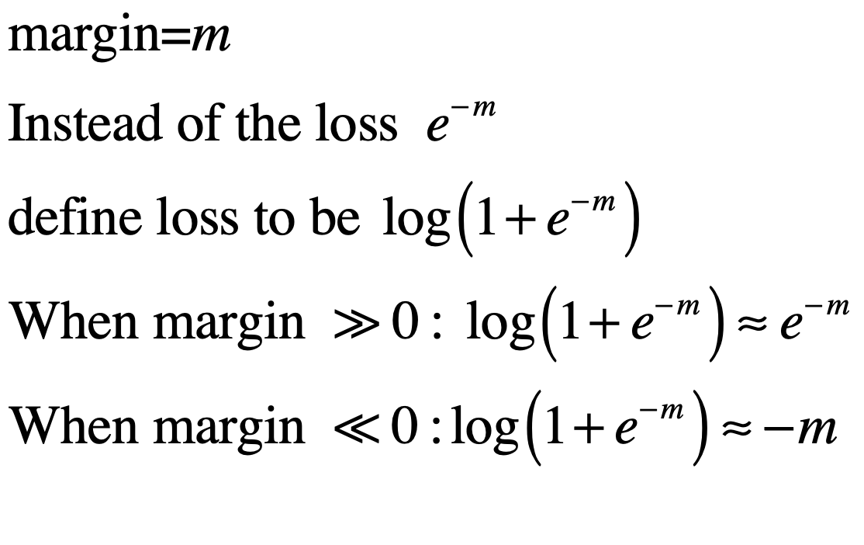
Logitboost as gradient descent
Also called Gentle-Boost and Logit Boost, Hastie, Freedman & Tibshirani
Logitboost loss
Adaboost (loss and weight)
Logitboost weight
Margin
Mistakes
Correct

Slide 38
Noise resistance
Adaboost:
perform well when a achievable error rate is close to zero (almost consistent case).
Errors = examples with negative margins, get very large weights, can overfit.
Logitboost:
Inferior to adaboost when achievable error rate is close to zero.
Often better than Adaboost when achievable error rate is high.
Weight on any example never larger than 1.

Slide 39
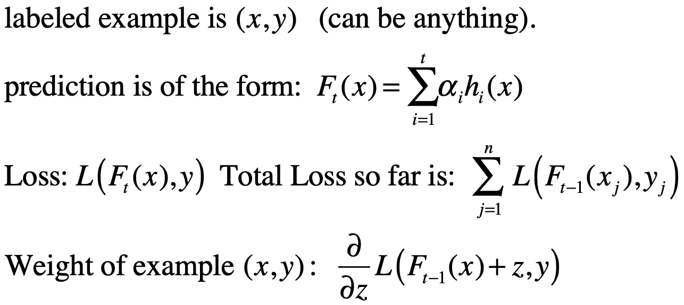
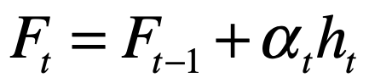
Gradient-Boost / AnyBoost
A general recipe for learning by incremental optimization
Applies to any (differentiable) loss function.
At each iteration:
calc example weights
call weak learner with weighted example
Add generated weak rule to create new rule:

Slide 40
Summary
Margin: Measures the “correctness” of the prediction.
Boosting can be viewed as a gradient descent over a loss function defined on the margin.
Different loss functions are popular:
Adaboost (exponential)
Logitboost (logistic)
Madaboost (Clipped exponential)
Next, some implementations of boosting.

Slide 41
Some weak learner styles

Slide 42
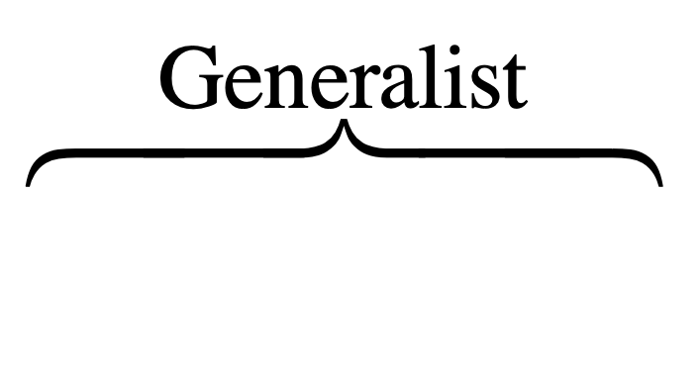
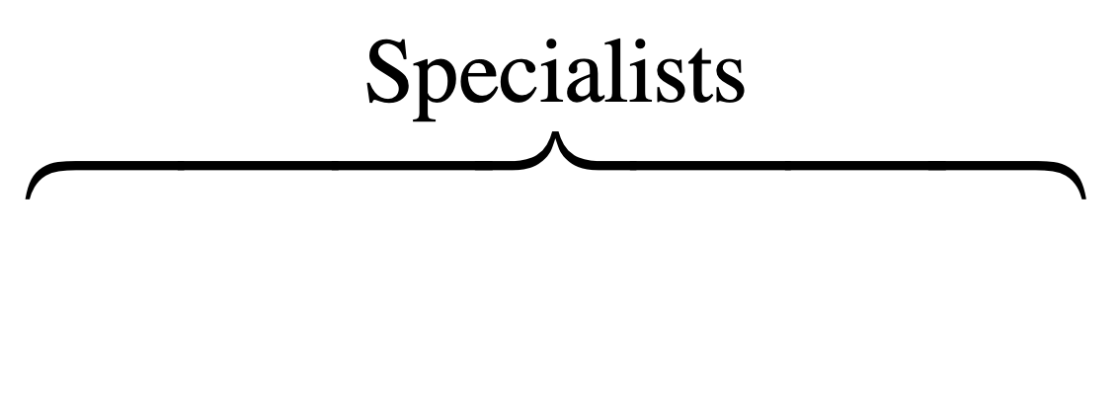
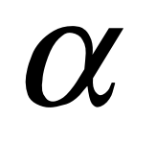


Styles of weak learners
Simple (stumps)
Complex (fully grown trees)
Everything in between (neural networks, Nearest neighbors, Naive Bayes,…..)
Season
Season
Season
Winter
Summer
Summer
Winter
-1
+1
+1
+1
Location
Prison
Beachh
Ski Slope
-1
Season
+1
Winter
Summer
-1
+1

Slide 43
Alternating Decision Trees
Joint work with Llew Mason

Slide 44
Decision Trees
Y
X>3
+1
no
yes
5
-1
Y>5
-1
no
yes
-1
-1
+1
X
3

Slide 45
Decision tree as a sum
Y
-0.2
+0.2
X>3
+1
yes
no
sign
-0.1
+0.1
-0.1
-1
-0.2
+0.1
Y>5
-0.3
yes
-1
no
-0.3
+0.2
X

Slide 46
An alternating decision tree
Y
-0.2
+0.2
+1
Y<1
X>3
no
yes
yes
no
sign
-1
0.0
+0.7
-0.1
+0.1
-0.1
+0.1
-1
Y>5
-0.3
yes
no
-0.3
+0.2
+0.7
+1
X

Slide 47
Example: Medical Diagnostics
Cleve dataset from UC Irvine database.
Heart disease diagnostics (+1=healthy,-1=sick)
13 features from tests (real valued and discrete).
303 instances.

Slide 48

Adtree for Cleveland heart-disease diagnostics problem

Slide 49
Cross-validated accuracy
Learning algorithm | Number of splits | Average test error | Test error variance
ADtree | 6 | 17.0% | 0.6%
C5.0 | 27 | 27.2% | 0.5%
C5.0 + boosting | 446 | 20.2% | 0.5%
Boost Stumps | 16 | 16.5% | 0.8%

Slide 50
Summary
Almost anything can be a weak learner
Popular choices:
Boosting Trees
Boosting Stumps
Alternating Decision Trees
A compact combination of averaging and splitting.
Good at representing independent or dependent features.

Slide 51
Boosting and over-fitting

Slide 52

Curious phenomenon
Boosting decision trees
Using <10,000 training examples we fit >2,000,000 parameters

Slide 53
Explanation using margins
0-1 loss
Margin

Slide 54

Explanation using margins
0-1 loss
No examples with small margins!!
Margin

Slide 55

Minimizing error using loss functions on margin
Hinge-Loss
Adaboost =
Logitboost
(logistic regression)
Loss
Brownboost
0-1 loss
Margin
Mistakes
Correct

Slide 56

Experimental Evidence

Slide 57





Theorem
Schapire, Freund, Bartlett & Lee
Annals of stat. 98
For any convex combination and any threshold
Fraction of training example
with small margin
Probability of mistake
Size of training sample
No dependence on number
of weak rules
that are combined!!!
VC dimension of weak rules

Slide 58

Suggested optimization problem
Margin

Slide 59
Idea of Proof
Find linear classifier with large margin
Large margin implies there is a cone of linear classifiers with close-to-minimal error.
Large margin test examples are classified identically by classifiers in cone.
The prediction on large margin test examples is insensitive to small changes in training set.
?
?
?
?
?
?
?
?
?
?
?

Slide 60

Why are large margins good?
On examples with large margin, the prediction is stable.
In other words, small changes in the training set will not cause the prediction to flip.
We can predict with confidence.
High confidence $≠$P(y|x) is close to 0 or to 1.
Has more to do with the stability of the classifier w.r.t. small changes in the training data.

Slide 61

confidence $≠$ certainty
Certainty: buy a stock and keep it for 20 years. You want to be close to certain that the stock will perform well.
Confidence: Each day you buy or sell a particular stock: if you can consistently be correct 51% of the days.
Poker: deciding whether to raise or fold: need to decide correctly more than your opponent.
Medical Diagnosis: ”In my experience, the majority of patients who present symptoms X suffer from condition Y”
Sport: read the body language of your opponent, don’t let your opponent read your body language.

Slide 62

Prediction in sports

Slide 63

Prediction of spin in table tennis
Backspin
To respond correctly, we need to predict whether the ball has backspin or topspin.
By the time the ball is hit, it is too late.
We predict from body posture, from experience with individual player,…
Definite action according to prediction.
Prediction has to be correct more often than incorrect
Topspin

Slide 64



Confidence in classification
High Certainty: $P\left(y | x\right)<ε or p\left(y | x\right)>1−ε$
High Confidence: Switching from $p\left(y | x\right)>1/2$ to $p\left(y | x\right)<1/2$ (or vice versa) would require large (and unlikely) changes to the training set.
X
Classifier
Training set
Training set
Learning algorithm
$$p(y=1|x)$$

Slide 65
The three sources of classification error
Bayes Error: the minimal error rate achieved when the true distribution is known (exactly).
Model Bias: error resulting from the inability of the model class to represent the true distribution.
Data Variation: error resulting from the difference between the training set and the true distribution.

Slide 66



quiz
3) Consider a slightly different distribution:
X={1,2,3} dist. is uniform.(1/3,1/3,1/3)
Y={-1,+1},
P(y=+1|x=1)=0.1
P(y=+1|x=2)=0.8
P(y=+1|x=3)=0.6 (instead of 0.3)
Bayes optimal classifier: f(1)= ,f(2)= ,f(3)=
Bayes Error =
Error of optimal rule from the set
1) Optimal Rule
X={1,2,3} dist. is uniform.(1/3,1/3,1/3)
Y={-1,+1},
P(y=+1|x=1)=0.1
P(y=+1|x=2)=0.8
P(y=+1|x=3)=0.3
Bayes optimal classifier: f(1)=-1,f(2)=+1,f(3)=?
Bayes Error = ?
4) Data Variation
In practice, we don’t know the conditional probabilities, we estimate them from data:
 | # Y=+1 | # Y=-1 | Empirical conditional Probability | True Conditional Probability
X=1 | 1 | 6 | $\hat{P}\left(y=+1 | x=1\right)=\frac{1}{6+1}$ | P$\left(y=+1 | x=1\right)=0.1$
X=2 | 8 | 2 | $$\hat{P}\left(y=+1 | x=2\right)= ?$$ | P$\left(y=+1 | x=2\right)$=?
X=3 | 2 | 3 | $\hat{P}\left(y=+1 | x=3\right)=$ ? | P$\left(y=+1 | x=3\right)$=?
2) Model Bias
Suppose our model allows only rules of the form
Give an optimal rule for the distribution defined above
What is the expected error of that rule?
How does it compare with the Bayes Optimal Rule?
For x=3 estimate is below 0.5, truth is above 0.5
Empirically optimal classifier : f(1)=-1, f(2)=+1, f(3)=-1
This rule is NOT the Bayes optimal rule, it was misled by
the empirical estimate for x=3. We say that the discrepancy is due to data variation.
The best rule of the form is equal to the Bayes optimal rule.

Slide 67
Example, Model Bias
Model Bias
Suppose our model allows only rules of the form
Give an optimal rule for the distribution defined above
What is the expected error of that rule?
How does it compare with the Bayes Optimal Rule?

Slide 68
Example, Data Variation (1)
Consider a slightly different distribution:
X={1,2,3} dist. is uniform.(1/3,1/3,1/3)
Y={-1,+1},
P(y=+1|x=1)=0.1
P(y=+1|x=2)=0.8
P(y=+1|x=3)=0.6 (instead of 0.3)
Bayes optimal classifier: f(1)= ,f(2)= ,f(3)=
Bayes Error =
Error of optimal rule from the set

Slide 69

Example, Data Variation (2)
Empirical estimation of the best rule
In practice, we don’t know the conditional probabilities, we estimate them from data:
 | # Y=+1 | # Y=-1 | Empirical conditional Probability | True Conditional Probability
X=1 | 1 | 6 | $\hat{P}\left(y=+1 | x=1\right)=\frac{1}{6+1}$ | P$\left(y=+1 | x=1\right)=0.1$
X=2 | 8 | 2 | $$\hat{P}\left(y=+1 | x=2\right)= ?$$ | P$\left(y=+1 | x=2\right)$=?
X=3 | 2 | 3 | $\hat{P}\left(y=+1 | x=3\right)=$ ? | P$\left(y=+1 | x=3\right)$=?
For x=3 estimate is below 0.5, truth is above 0.5
Empirically optimal classifier : f(1)=-1, f(2)=+1, f(3)=-1
This rule is NOT the Bayes optimal rule, it was misled by
the empirical estimate for x=3. We say that the discrepancy is due to data variation.
The best rule of the form IS equal to the Bayes optimal rule.

Slide 70
Methods for reducing data variation for classifiers
Model Selection: Choosing the number of parameters in the model.
Weight Decay: Decreasing the magnitude of the parameters
Margins: increasing the classification margin. (Boosting, Support Vector Machines)
Bagging: Taking the majority vote over randomize choice of training set.

Slide 71
Tradeoffs
Weight decay, reducing the number of parameters decrease data variation, increase model bias.
Bagging decreases data variation without significantly increasing model bias.
Boosting reduces both variation and model bias.

Slide 72

The Bias/Variance tradeoff for squared error
The squared error can always be decomposed into a bias term and a variance term.
For regression:
Increasing the number of features decreases bias and increases variance.
Reducing the size of the weights (Ridge regression, Lasso) Increases bias and decreases variance.

Slide 73
Random Forests and Bagging
Bagging: Bootstrap Aggregation
Bagging+Decision threes = Random forests
Run CART, considering a random small subset of the features at each iteration.
Examples are NOT reweighted.
Take a majority vote over many trees.
A very fast, flexible and accurate algorithm.
Natural notion of margins.
Faster than boosting and as accurate.
The generated rules are bigger than corresponding ADTrees.

Slide 74
Applications
of Boosting

Slide 75
Applications of Boosting
Academic research
Applied research
Commercial deployment

Slide 76
Academic research
% test error rates
Database | Other | Boosting | Error reduction
Cleveland | 27.2 (DT) | 16.5 | 39%
Promoters | 22.0 (DT) | 11.8 | 46%
Letter | 13.8 (DT) | 3.5 | 74%
Reuters 4 | 5.8, 6.0, 9.8 | 2.95 | ~60%
Reuters 8 | 11.3, 12.1, 13.4 | 7.4 | ~40%
Notes:
Cleveland: Heart disease, features: blood pressure, etc.
Promoters: DNA, indicates that intron is coming
Letter: standard b&w OCR benchmark, Frey & Slate 1991, Roman alphabet, 20 distorted fonts,
16 given attributes: # pixels, moments etc.
Reuters-21450, 12,902 documents, standard benchmark,
Reuters 4: first table A9, A10. Naïve bayes CMU, Rocchio,

Slide 77
Applied research
Schapire, Singer, Gorin 98
“AT&T, How may I help you?”
Classify voice requests
Voice -> text -> category
Fourteen categories
Area code,
AT&T service,
billing credit,
calling card,
collect,
competitor
competitor,
dial assistance,
directory,
how to dial,
person to person,
rate,
third party,
time charge
Notes:
AT&T service – sign up or drop

Slide 78
Example transcribed sentences
Yes I’d like to place a collect call long distance please
Operator I need to make a call but I need to bill it to my office
Yes I’d like to place a call on my master card please
I just called a number in Sioux city and I musta rang the wrong number because I got the wrong party and I would like to have that taken off my bill
collect
third party
calling card
billing credit

Slide 79

Weak rules generated by “boostexter”
Third party
Categories
Calling card
Collect call
Weak Rule
Word occurs
Word does
not occur

Slide 80
Results
7844 training examples
hand transcribed
1000 test examples
hand / machine transcribed
Accuracy with 20% rejected
Machine transcribed: 75%
Hand transcribed: 90%

Slide 81
Commercial deployment
Freund, Mason, Rogers, Pregibon, Cortes 2000
Distinguish business/residence customers
Using statistics from call-detail records
Alternating decision trees
Combines very simple rules
Can over-fit, cross validation used to stop
Notes:
3 years for fraud

Slide 82
Massive datasets (for 1997)
260M calls / day
230M telephone numbers
Label unknown for ~30%
Hancock: software for computing statistical signatures.
100K randomly selected training examples,
~10K is enough
Training takes about 2 hours.
Generated classifier has to be both accurate and efficient
Notes:
Call detail: originating, called, terminated (e.g, for 800, forwarding) #,
start, end time, quality, termination code (e.g., for wireless), quality, no rate information
Statistics: #calls, Distribution within day, week, # #’s called, type (800, toll, etc.), incoming vs. outgoing

Slide 83

Alternating tree for “buizocity”

Slide 84

Alternating Tree (Detail)

Slide 85

Precision/recall graphs
Accuracy
Score

Slide 86
Business impact
Increased coverage from 44% to 56% for Accuracy ~94%
Saved AT&T 15M$ in the year 2000 in operations costs and missed opportunities.

Slide 87
Face Detection
Viola and Jones / 2001

Slide 88

Face Detection / Viola and Jones
Live demo in 2001 conference.
Higher accuracy than manually designed state of art
Real -time using 2001 laptop
Many Uses
Standard feature in cameras
User Interfaces
Security Systems
Video Compression
Image Database Analysis
Notes:
Here is the basic problem… scan the image and find all faces labelling them with their scale and location
This actually the output of our system… perhaps we have gotten a bit lucky but this sort of performance is typical
Note the system is limited to frontal upright faces… more general poses are work in progress.

Slide 89

Face Detection as a Filtering process
Larger
Scale
Smallest
Scale
50,000 Locations/Scales
Most Negative

Slide 90


Classifier is Learned from Labeled Data
Example: 28x28 image patch
Label: Face / Non face
5000 faces, 10⁸ non faces
Faces are normalized
Scale, translation
Rotation remains…
Notes:
This situation with negative examples is actually quite common… where negative examples are free.

Slide 91



Image Features
“Rectangle filters”
Similar to Haar wavelets
Papageorgiou, et al.
Very fast to compute using
“integral image”.
Unique Binary Features
Combined using adaboost
Notes:
For real problems results are only as good as the features used...
This is the main piece of ad-hoc (or domain) knowledge
Rather than the pixels, we have selected a very large set of simple functions
Sensitive to edges and other critcal features of the image
** At multiple scales
Since the final classifier is a perceptron it is important that the features be non-linear… otherwise the final classifier will be a simple perceptron.
We introduce a threshold to yield binary features

Slide 92
The Integral Image
Each pixel in the integral image is the sum of pixels above and to the left in original image.

Slide 93

Efficient computation of Integral image
Row integral
The sum of the row integral and the yellow image integral gives the red image integral

Slide 94

Cascaded boosting
Features combined using Adaboost
Find best weak rule by exhaustive search.
Ran for 2 days on a 250 node cluster
For detection, features combined in a cascade:
Runs in real time, 15 FPS, on laptop

Slide 95

Paul Viola and Mike Jones

Slide 96
Summary
Boosting is a computational method for learning accurate classifiers
Resistance to over-fit explained by margins
Boosting has been applied successfully to a variety of classification problems

Slide 97
Summary
Boosting has been applied in a large variety of domain.
Boosted trees is one of the most popular methods in Kaggle competitions.
The work goes into designing informative features.
Boosting works well when the classifier depends on a small subset of the features.

Slide 98
Boosting under high noise.

Slide 99
Adaboost is sensitive to label noise
Letter / Irvine Database
Focus on a binary problem: {F,I,J} vs. other letters.
Label Noise | Adaboost | Logitboost
0% | 0.8% ±0.2% | 0.8% ±0.1%
20% | 33.3% ±0.7% | 31.6% ±0.6%
Boosting puts too much weight on outliers.
Need to give up on outliers.

Slide 100
Robustboost - A new boosting algorithm
Label Noise | Adaboost | Logitboost | Robustboost
0% | 0.8% ±0.2% | 0.8% ±0.1% | 2.9% ±0.2%
20% | 33.3% ±0.7% | 31.6% ±0.6% | 22.2 ±0.8%
error with respect to original (noiseless) labels
20% | 22.1% ±1.2% | 19.4% ±1.3% | 3.7% ±0.4%

Slide 101
Approximating mistake loss with convex functions
Hinge-Loss
Adaboost =
Logitboost
(logistic regression)
Loss
Brownboost
0-1 loss
Margin
Mistakes
Correct

Slide 102
Label noise and convex loss functions
Algorithms for learning a classifier based on minimizing a convex loss function: perceptron, Adaboost, Logitboost, Logistic regression, soft margins SVM.
Work well when data is linearly separable.
Can get into trouble when not linearly separable.
Problem: Convex loss functions are a poor approximation for classification error.
But: No known efficient algorithms for minimizing a non-convex loss function.

Slide 103
Random label noise
defeats any convex loss function
[Servedio, Long 2010]

Slide 104
Considering one symmetric half
[Servedio, Long 2010]

Slide 105
Adding random label noise
[Servedio, Long 2010]
“Puller”
Theorem: for any convex loss function there exists a linearly separable distribution
such that when independent label noise is added, the linear classifier that minimizes
the loss function has very high classification error.
“Large Margin”
“Penalizers”

Slide 106
Boost by majority, Brownboost, RobustBoost
Target error set at start.
Defines how many boosting iterations are needed
The loss function depends on the time-to-finish.
Close to end - give up on examples with large negative margins.
Notes:
Meaning of potential for BBM.

Slide 107


Slide 108


Slide 109


Slide 110


Slide 111


Slide 112


Slide 113


Slide 114


Slide 115


Slide 116


Slide 117


Slide 118





Slide 119
Experimental Results
on Long/Servedio
synthetic example

Slide 120

Adaboost on Long/Servedio

Slide 121

LogitBoost on Long/Servedio

Slide 122

Robustboost on Long/Servedio

Slide 123
Experimental Results
on real-world data

Slide 124
Robustboost - A new boosting algorithm
Label Noise | Adaboost | Logitboost | Robustboost
0% | 0.8% ±0.2% | 0.8% ±0.1% | 2.9% ±0.2%
20% | 33.3% ±0.7% | 31.6% ±0.6% | 22.2 ±0.8%
error with respect to original (noiseless) labels
20% | 22.1% ±1.2% | 19.4% ±1.3% | 3.7% ±0.4%

Slide 125
Logitboost
0% Noise

Slide 126


Slide 127


Slide 128


Slide 129


Slide 130
Logitboost
20% Noise

Slide 131


Slide 132


Slide 133


Slide 134


Slide 135


Slide 136
Robustboost
20% Noise

Slide 137


Slide 138


Slide 139


Slide 140


Slide 141


Slide 142


Slide 143


Slide 144


Slide 145


Slide 146

JBoost V2.0

Slide 147
Parallelizing Boosting
Map-reduce not good because stateless
Split features among slaves. Data stays in memory between iterations.
Each slave finds his best weak rule
Master chooses overall best weak rule.
When weights get very skewed, flush memory and collect examples filtering them by weight.
Concentrates on the hard examples
Can be combined with Co-training / Active learning.

Slide 148
Co-training

Slide 149





Slide 150

Subtract-average detection score
Grey-scale detection score

Slide 151
Summary
Boosting is a method for learning an accurate classifiers by combining many weak classifiers.
Boosting is resistant to over-fitting.
Margins quantify prediction confidence.
High noise is a serious problem for learning classifiers- can’t be solved by minimizing convex functions.
Robustboost can solve some high noise problems. Exact characterization still unclear.
Jboost - an implementation of ADTrees and various boosting algorithms in java.
Book on boosting coming this spring.
Thank you, questions?

